Slide 1
Krusty Krab and Big Data
Applying big data on restaurants business

Slide 2
Team Members
01
Abdirahman Abdullahi 1432401
02
Mohamed Alrefaei 1617111
03
Dr. Raini Binti Hassan (Instructor)
04
Asem Hamood Al-Abdali 1513599
05
MHD Khaled Maen 1523591

Slide 3
Key Points
Intro.
results
Introduction
Methodology
Result

Slide 4
Introduction
Restaurants are on the top of business ideas it falls into the hospitality business category
Restaurant business plan varies from person to person.
The rate of startup restaurant first-year failure which is a 23% failure rate at their first year.
understand and analyze the data and the best Circumstances for a restaurant to success and what are the most favourite food cuisines to the students.

Slide 5
Methodology
Business understating
Data set
Data preprocessing
Understanding the students’ tastes of food types.
61 attributes of students prefers regarding to food and diet.
Drop the less significant attribute and fill the missing values.
Algorithm
Evaluation
Since our problem is unsupervised machine learning clustering K-Means tend to be suitable for the task
Elbow Method: find a good K based on SSE.
Silhouette Analysis: the average distance from all data point

Slide 6
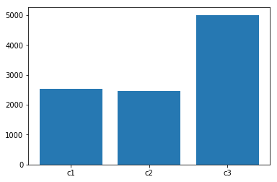
Result
After 10000 iterations with k=3, K-Means algorithm revealed that the students who are clustered in c3 are 50% of the whole data, in that Krusty krab will target this group and try to add additional meals to approach the one of the remaining groups or both of them

Slide 7
Thank you

